Slide 1

Easier Data Access with Chatbot
PRESENTED BY
BITS N BYTES

Slide 2
UNDERSTANDING THE PROBLEM
Users need a simple way to ask questions in natural language instead of navigating a portal to find resources.
The system must automatically identify relevant datasets from databases.
It should generate insights (charts, tables, summaries) instead of raw data.
The focus is on making data accessible and interactive, not just stored

Slide 3
SOLUTION PROPOSED TO THE PROBLEM
A comprehensive analytic dashboard for background check with natural language query processing and automated visualizations will be built.
This dashboard provides an intelligent interface for analyzing background verification data through natural language queries. It automatically generates SQL queries, creates appropriate visualizations, and offers downloadable results.
FEATURES:
Natural Language Processing: Ask questions in plain English about your background check data
Automated SQL Generation: Converts natural language to optimized SQL queries
Smart Visualizations: Automatically selects the best chart type based on your data
Interactive Dashboard: Real-time query processing with immediate results
Data Export: Download results as CSV files
Security-First: Built-in SQL injection protection and query validation
Multi-Table Support: Handles complex joins across multiple data tables

Slide 4
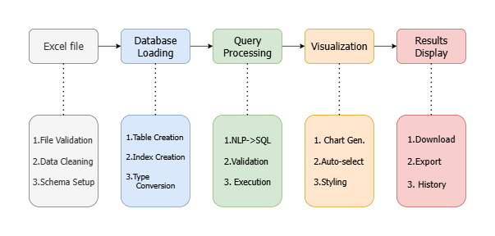
WORKFLOW OF DASHBOARD

Slide 5
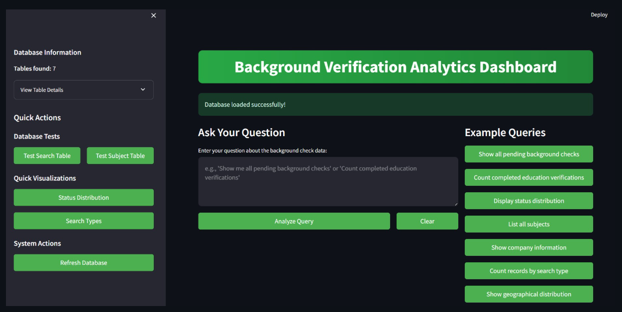
Home Dashboard UI
Quick Action and Visualizations
Ask query here
Submit your query
Some example queries

Slide 6
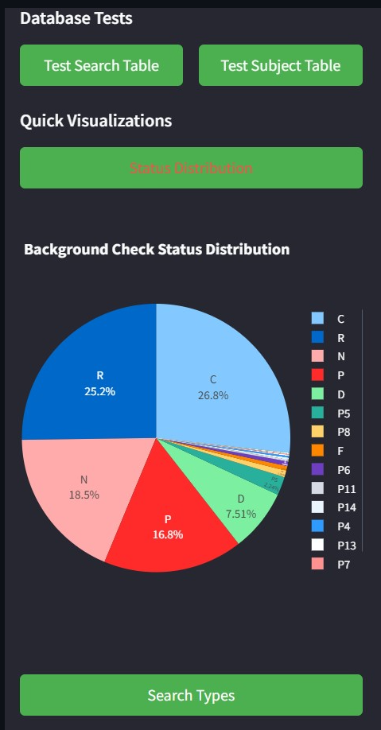
Main Dashboard Interface with Query Input and Navigation

Slide 7
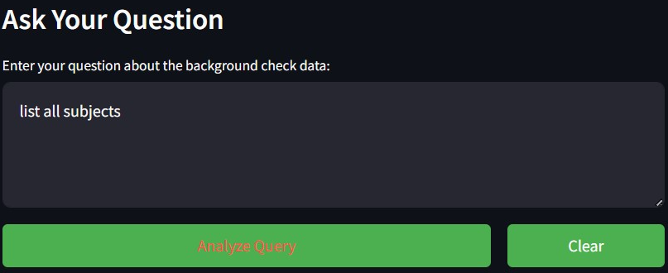
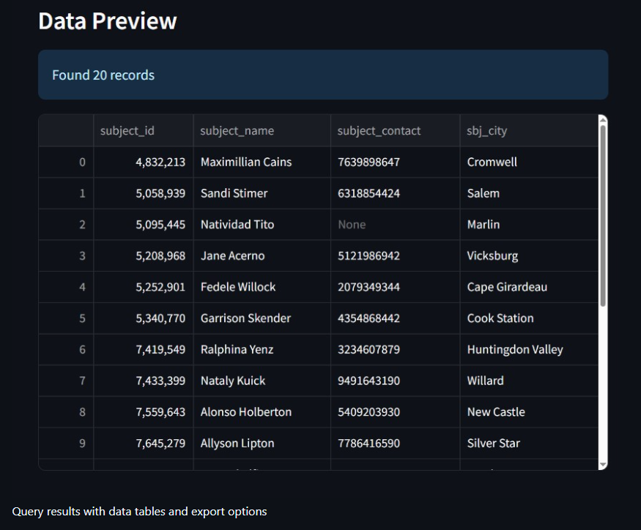
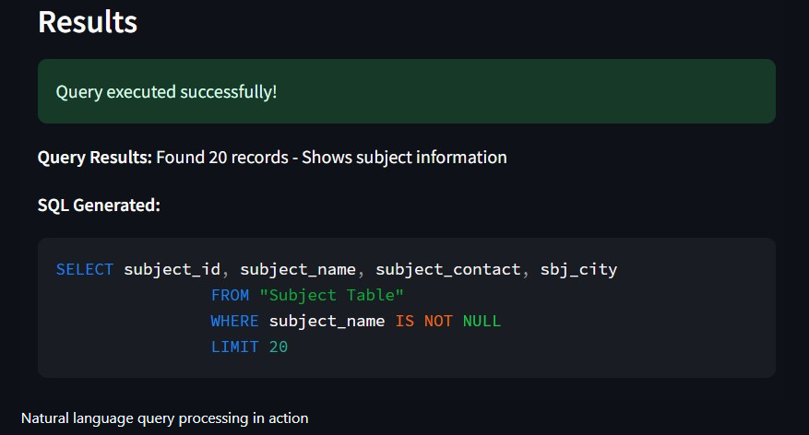
Working
1: Ask your Query
2: NLP Processing
3: Query Result Display

Slide 8
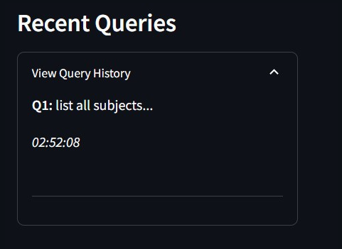
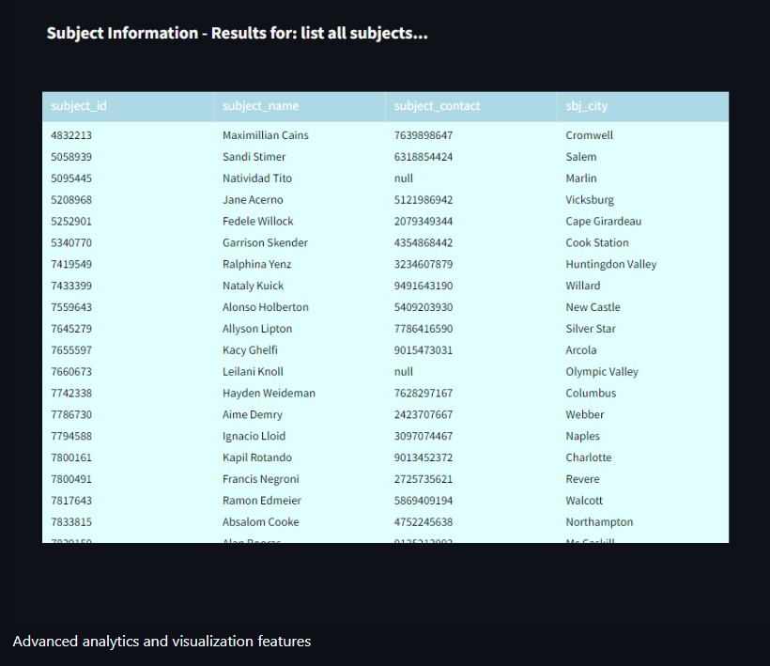
Working
5: Visualization
(Downloadable file is generated)
6: Recording Search History

Slide 9
OPTIMIZATION PROPOSED (IDEA 1)
Current Challenge:
Accurate’s existing data model lacks critical timing and vendor tracking capabilities
No visibility into process duration for background verification requests
Missing third-party vendor information affects cost analysis and process optimization
Proposed Enhancement:
We propose adding 3 strategic columns to optimize Accurate's operational efficiency:
1. Subject Package Execution Start Time
Purpose: Track when background verification process begins
2. Subject Package Execution Completion Time
Purpose: Record completion timestamp (NULL if ongoing)
3. Involvement of third-Party
Purpose: Track external verification services used (TRUE if third party is involved)

Slide 10

CHANGES IN DATABASE SCHEMA
Order Table (Enhanced):
Column | Type | Purpose
orderid | Int | Existing primary key
orderPackageId | Varchar | Existing package reference
orderSubjectID | Int | Existing candidate reference
orderCompanyCode | Varchar | Existing company reference
orderStatus | varchar | Existing status tracking
Subject_request_start_time | datetime | NEW: Package Execution Start timestamp
Subject_request_end_time | datetime | NEW: Package Execution Completion (NULL if ongoing)
involves_third_party | boolean | NEW: TRUE if external vendor required

Slide 11
OPTIMIZATION PROPOSED (IDEA 2)
Client-Wise Visibility: HR departments will be able to see their company's candidate data​
Accurate-Side Visibility: Complete visibility across all clients and candidates, i.e how many total people have submitted their data, how many are pending and also client wise analytics of the same.​
Forms integration: Gathering data using forms can streamline and ease the process of collecting data​
Real-Time Analytics: Interactive charts and progress monitoring for the amount of data received​
Analytics details​:
For Client side:​
View only their company's candidates and progress​
Bar charts: Filled vs pending forms within their company​
Data Isolation: Complete segregation ensures clients never see other companies' information​
For Accurate:​
Global dashboard with all client companies​
Ability to access individual company analytics​

Slide 12
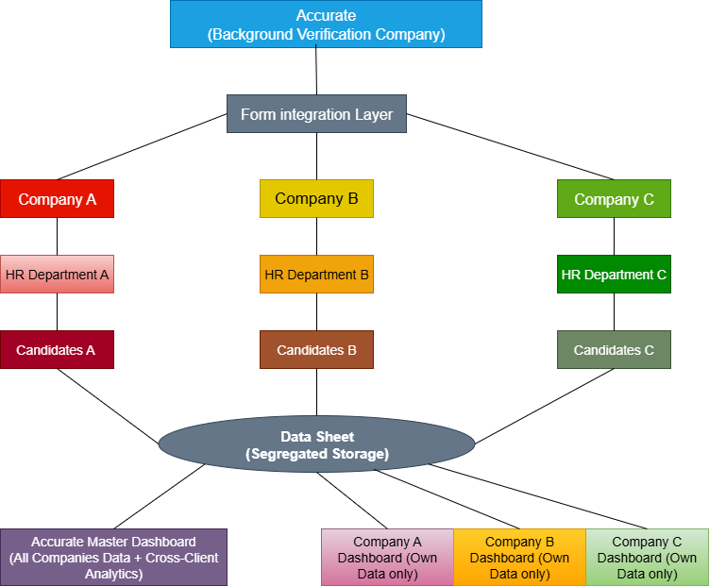
FLOWCHART OF IDEA 2

Slide 13
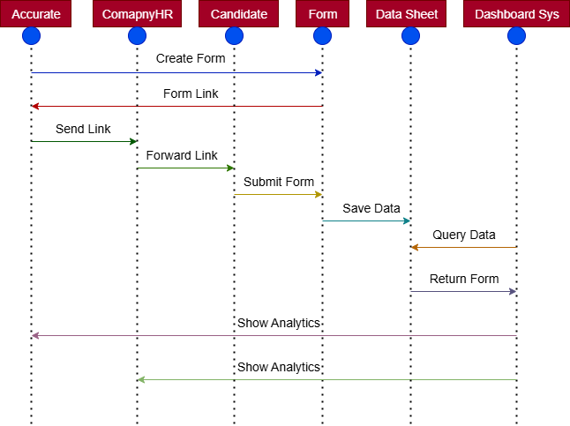
Accurate Verification System Flow

Slide 14
Conclusion & Next Steps
Benefits of Solution Proposed
Provides an intelligent dashboard for background verification analytics
Bridges natural language queries → SQL → Visualizations
Ensures security, scalability, and usability
Benefits of Optimization Proposed
Efficient Cost Analysis
Efficient Client’s data status analysis
Next Steps:
Expand visualization types
Add support for larger datasets & real-time APIs
Enhance NLP accuracy

Slide 15

Any Questions ?

Slide 16
Thank You
FOR YOUR TIME

